Slide 1
Regional Economic Prospects
November 2018
IN THE SHADOW OF TRADE CONFLICTS
Sustained growth amidst tighter financing conditions

Slide 2
Solid growth momentum but financing conditions tightening, trade wars escalating, dearer oil
Growth in the EBRD regions in H1 2018 unchanged at 3.8%
Financing conditions for emerging markets remain favourable but the tide has turned
Reflecting change of policy mix in the US (fiscal stimulus. Monetary tightening)
Exposing weaknesses in selected emerging markets – Argentina, Turkey, South Africa/Zambia
Escalating trade wars could, in an extreme scenario, lead to unwinding of global value chains with profound impact on economies globally
In general, the region is more strongly reliant on global value chains than most EMs, hence high risks
Ability to reconstruct value chains domestically / regionally will depend on innovation capabilities, quality of management, size of markets
Higher oil prices
Stronger global demand, lower supply (from Venezuela), production caps by OPEC + Russia, infrastructure bottlenecks holding back supply of shale oil

Slide 3
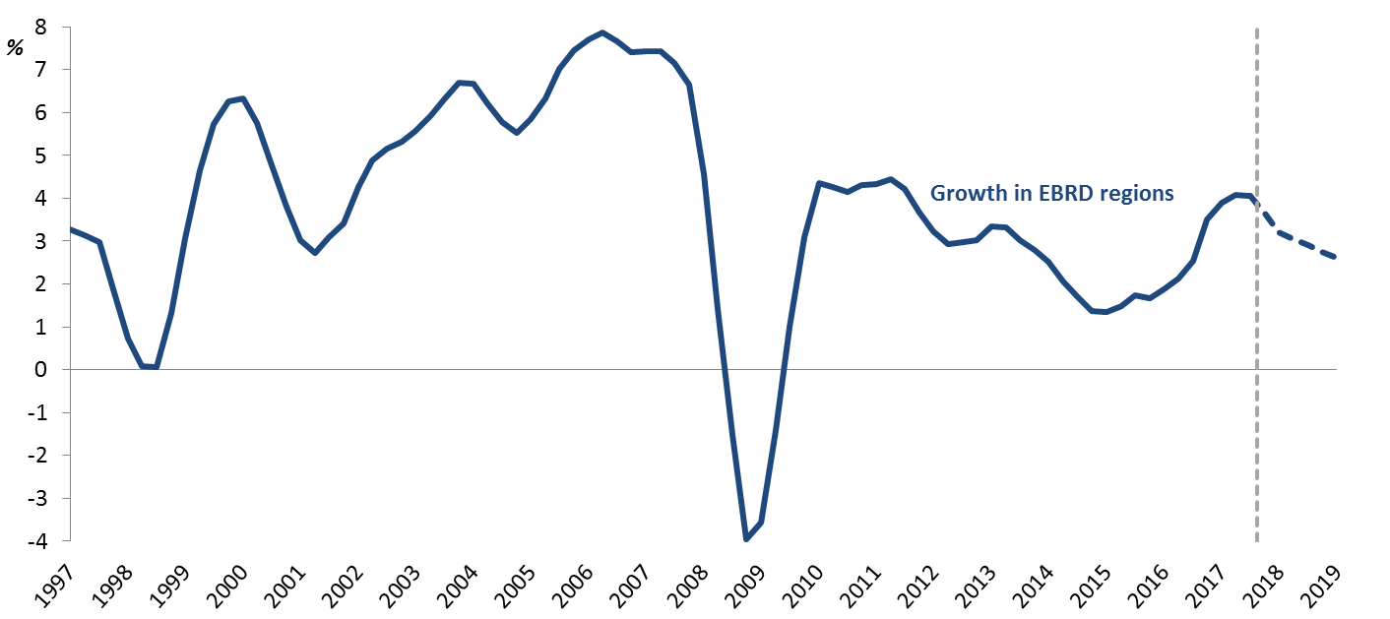
On a 12-month rolling basis, growth reached 4.1% at end-June 2018
Signs of deceleration in H2 2018 based on the latest economic indicators such as retail sales, exports and imports
Growth in the EBRD region, 12-month rolling basis, %
Source: National authorities via CEIC, IMF and authors’ calculations. Dotted line represents a combination of nowcast based on 152 global indicators. And estimates of long-term potential growth across economies.

Slide 4
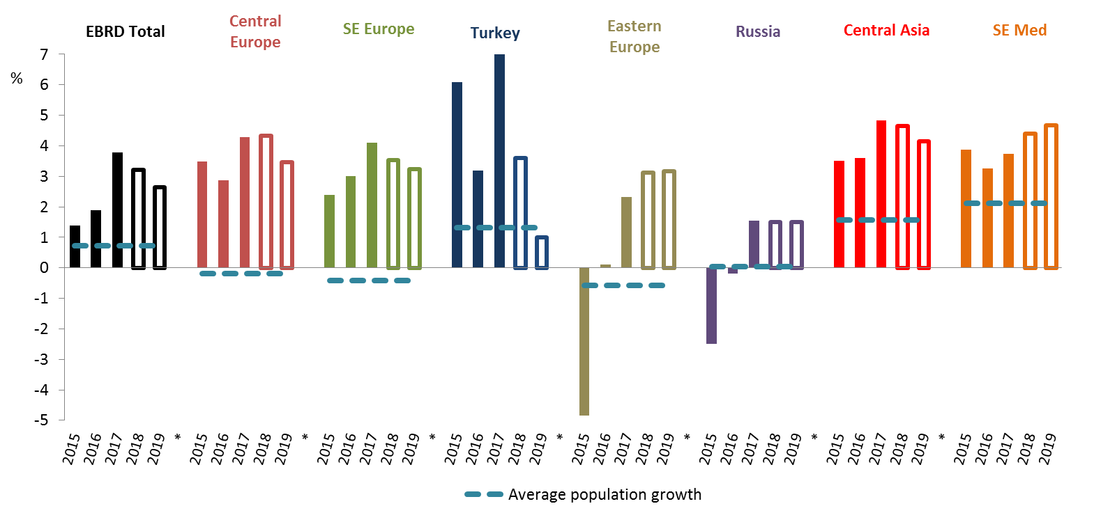
EBRD regions to grow at 3.2% in 2018 and 2.6% in 2019, downward revision on account of Turkey
Revision of -0.1pp 2018 and -0.6pp in 2019 compared with the May 2018 forecast
Primarily on account of slower expected growth in Turkey, where a sharp deceleration in the second half of the year is expected to bring the 2018 growth down to 3.6%; 1% growth is expected in 2019
GDP growth and population growth by sub-regions, %
Source: IMF, EBRD and authors’ calculations. Growth averages are population-weighted.

Slide 5
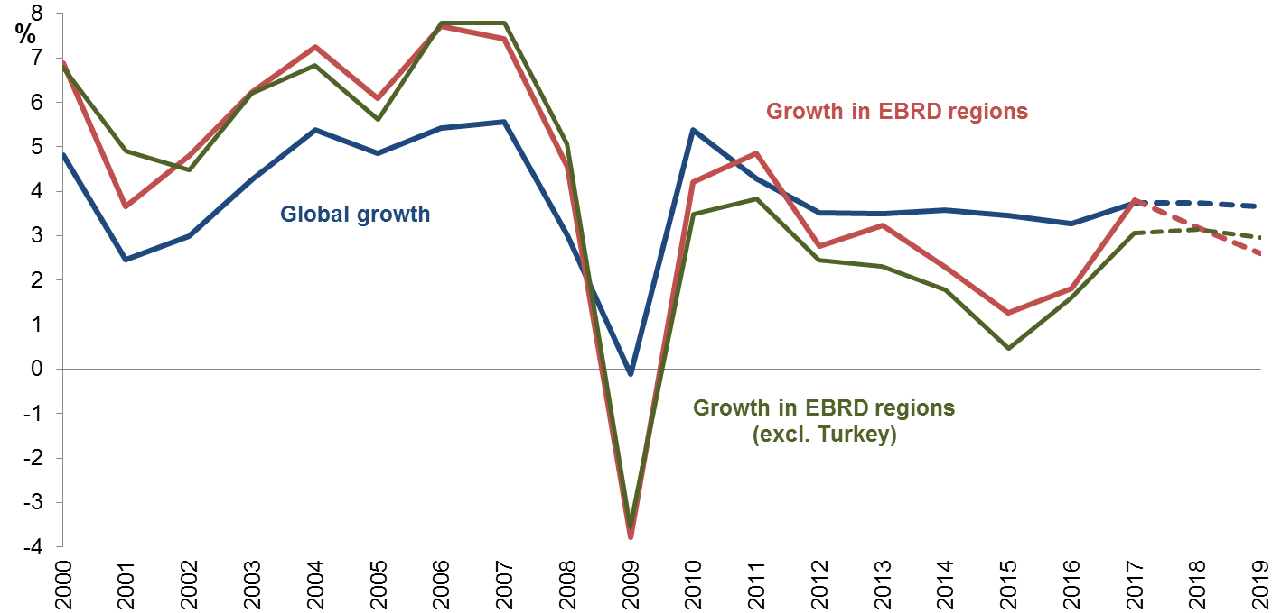
Growth in EBRD regions ex. Turkey revised up by 0.1 pp, to 3.1% in 2018, decelerating to 3% in 2019
An upward revision of 0.1pp in 2018; unchanged forecast in 2019
Global growth and in the EBRD region (excluding Turkey), %
Source: IMF and EBRD.

Slide 6
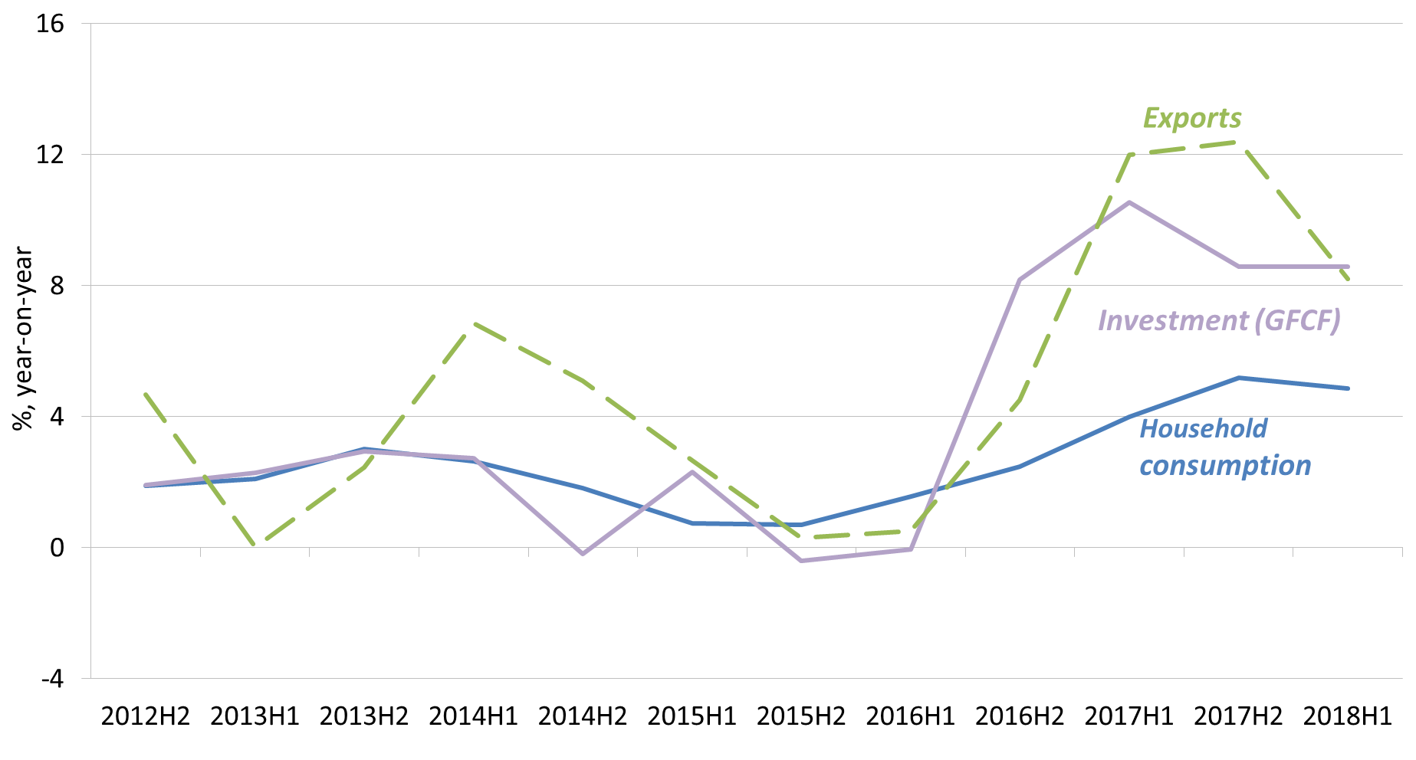
Growth in H1 2018 unchanged from 2017 at 3.8%; composition shifted towards private consumption
Typical of later stage in the economic cycle
Exports and investment still make an important contribution to growth but a smaller one than in 2017
Change in exports, investment and private consumption in the EBRD regions, year-on-year
Source: National authorities via CEIC. Average is based on up to 22 economies for which quarterly data are available.

Slide 7
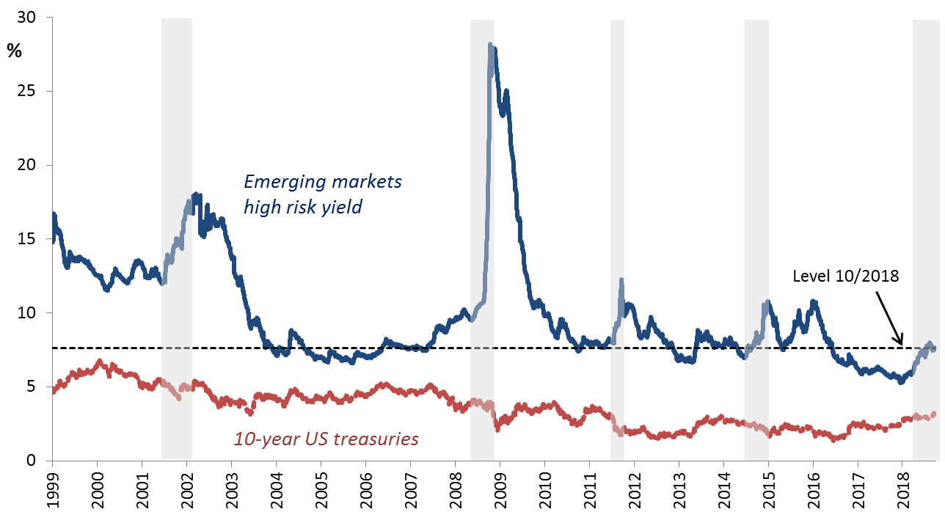
EM financing conditions now tightening but remain neutral-to-favourable in historical perspective
5th largest increase in average interest rates faced by EMs in the last 20 years, following the 2008 global financial crisis, an episode in 2001, the eurozone debt crisis of 2011 and an episode in 2015
But interest rates remain at the lowest levels seen in the last 20 years, comparable to 2003-07; 2013-15
Yields, %
Source: Bloomberg.

Slide 8
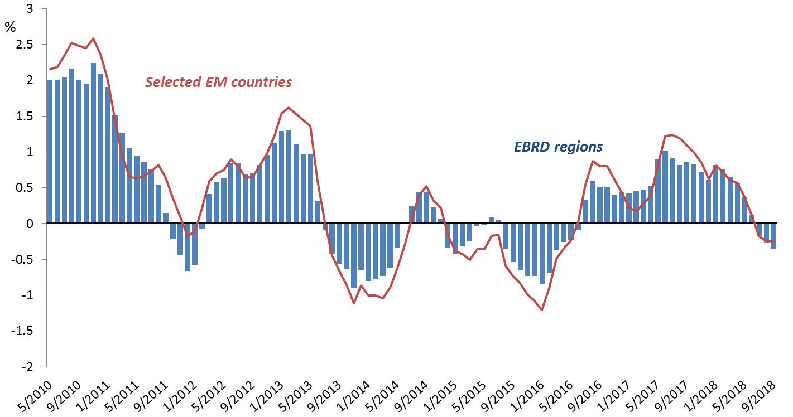
Capital flows to emerging markets and the EBRD regions have moderated
Tighter financing conditions have primarily affected capital flows to economies with underlying weaknesses, notably Argentina and Turkey
Net mutual fund flows to the EBRD regions, 6-months moving average,
% of assets under management
Source: EPFR Global. Emerging market countries: Argentina, Brazil, Chile, China, South Korea, Indonesia, Malaysia, Mexico and the Philippines.

Slide 9
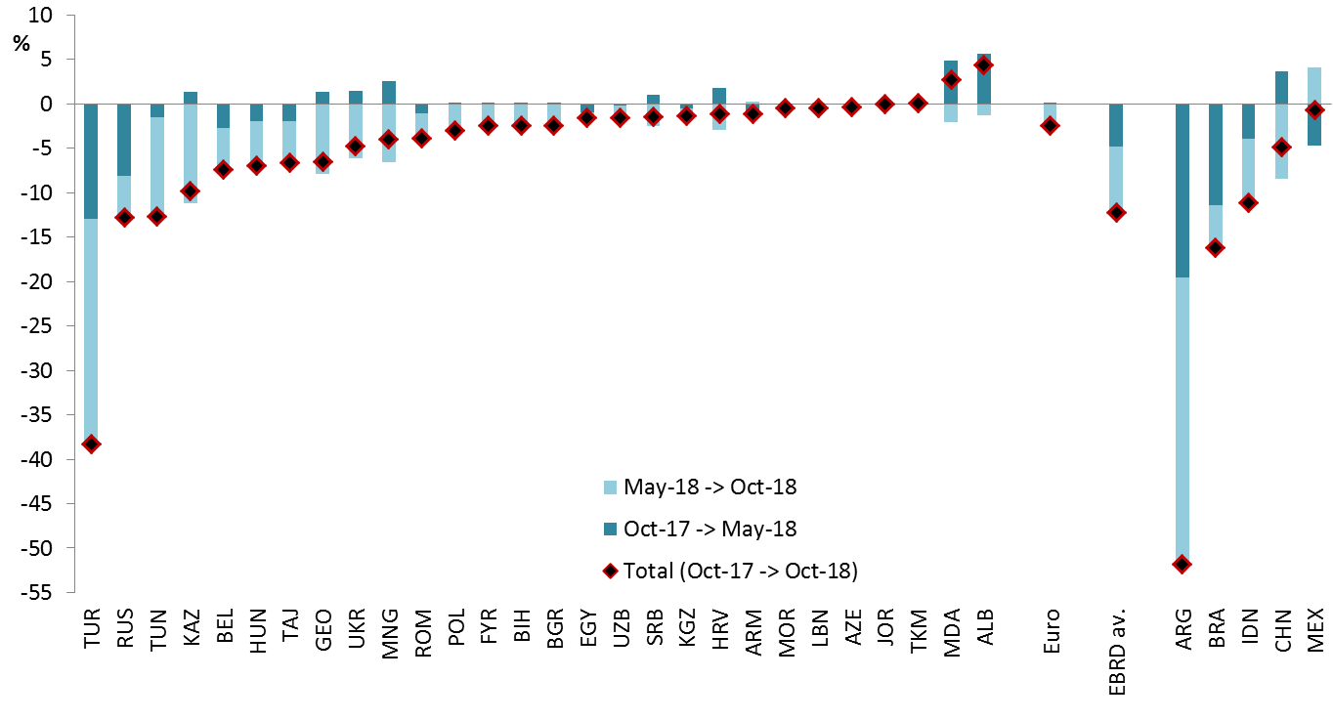
The region’s currencies weakening against the US dollar was limited to 8%, on average, in May-October 2018
Exchange rate movements against the US dollar, %
Source: National authorities via CEIC, Thomson Reuters and authors’ calculations.

Slide 10
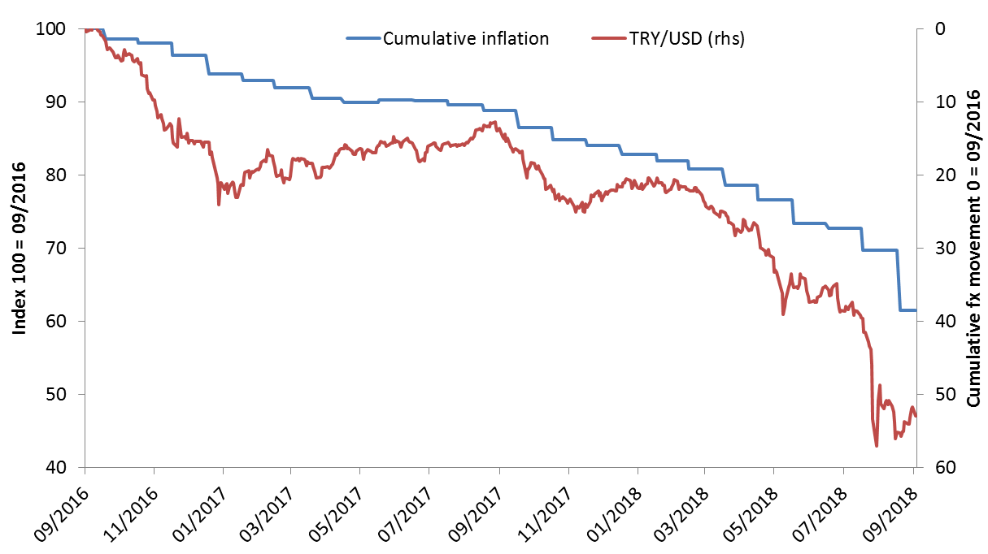
Yet Turkish Lira depreciated by 36% in Jan-Oct 2018, hit by a crisis of confidence among investors
Reflecting concerns about domestic policy and geopolitical risks
With a strong pass-through to inflation
Turkey: nominal exchange rate and inflation, index 09/2016 - 10/2018
Source: Thomson Reuters, national authorities and author’s calculation.

Slide 11
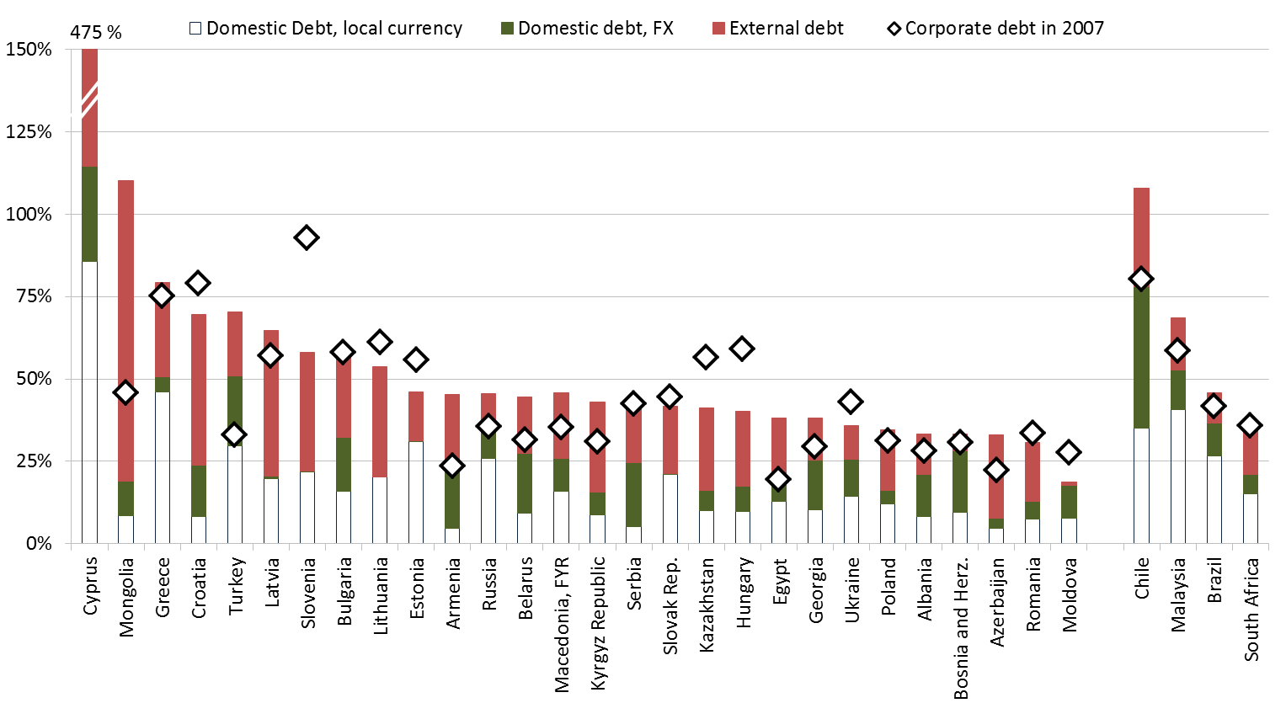
Other economies where forex debt rose fast may also be vulnerable as the US dollar strengthens
Non-financial sector corporate debt, % of GDP
Source: National authorities via CEIC; IMF, WB, BIS, OECD via Joint External Debt Hub. Domestic debt numbers are based on bank balance sheet data from national sources. External Debt data consists of external loans from BIS reporting banks, as well as international debt securities.

Slide 12
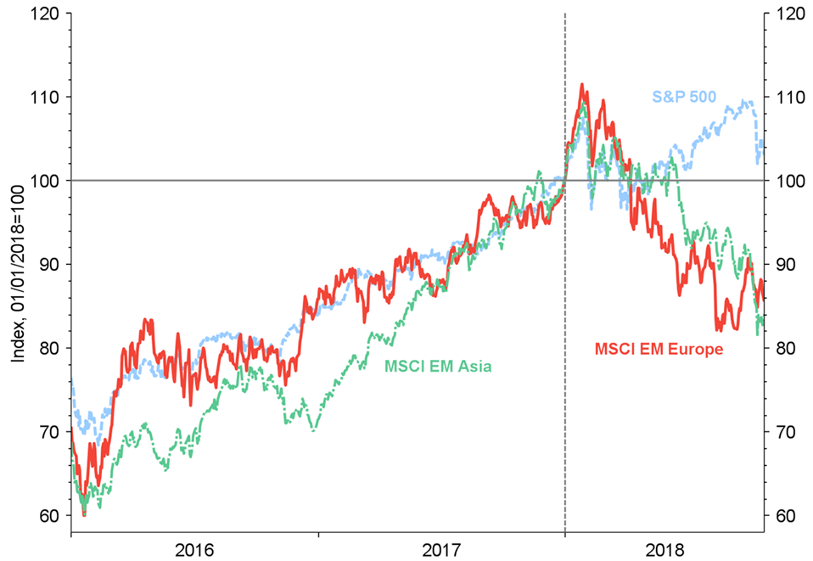
Stock market valuations in Emerging Europe weakened by 11% in May-Oct, back to levels of mid-2017
Other emerging markets also experienced a downward correction on concerns about further tightening of financing conditions and escalating trade wars
Stock market index, 1 Jan 2018 = 100, US$ terms
Source: Thomson Reuters. EM Europe countries include: the Czech Republic, Greece, Hungary, Poland, Russia and Turkey. Emerging Markets Asia countries include: China, India, Indonesia, Korea, Malaysia, Pakistan, the Philippines, Taiwan and Thailand.

Slide 13
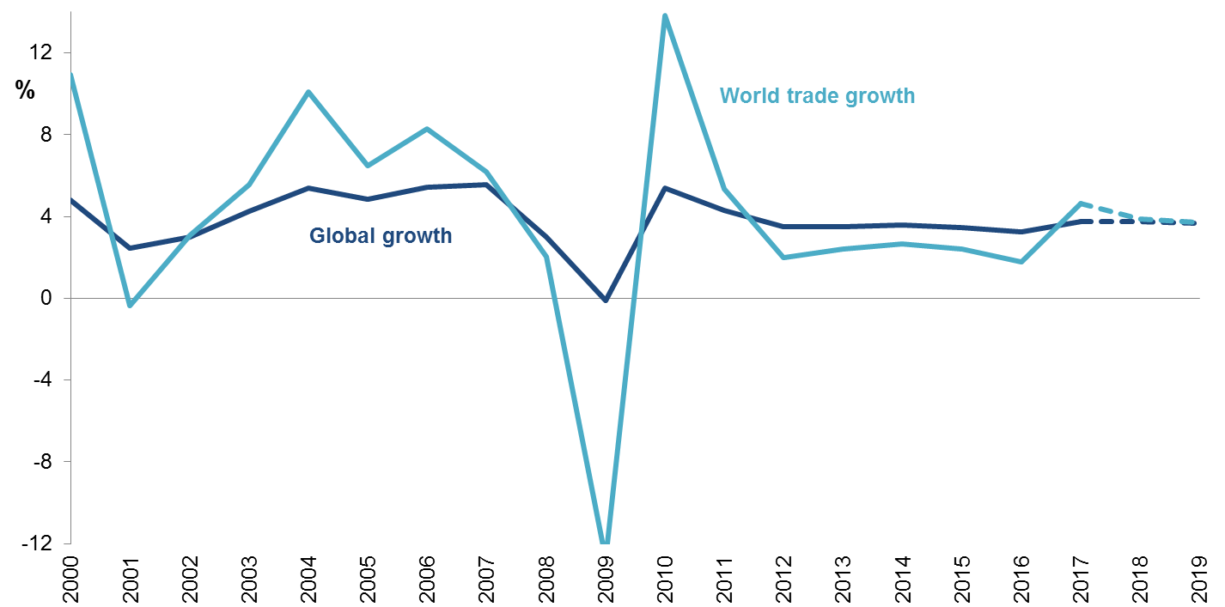
Global trade growth has been slowing down again after spiking in 2017
Global growth, %
Source: World Trade Organisation (WTO) and authors’ calculations. GDP growth is weighted using purchasing power parity-based values.

Slide 14
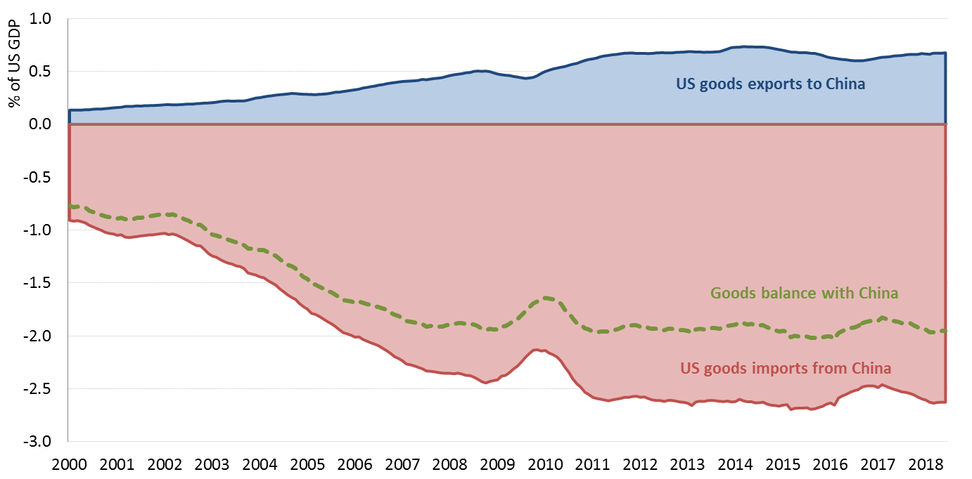
The art of no deal: Who is most at risk in an extreme trade wars scenario?
US imposed 10% tariff on ≈ 45% (US$ 230+ billion) of imports from China, rising to 25% tariff on 1 Jan 19
China has so far responded by imposing tariffs on $60 billion worth of US imports, may restrict exports
NAFTA → USMCA with stricter rules of origin for cars, wage requirements: to be ratified
Earlier in March, US imposed additional tariffs on steel (25%) and aluminium (10%) including from the EU
US trade with China, % of GDP
Source: Thomson Reuters and author’s calculation.

Slide 15
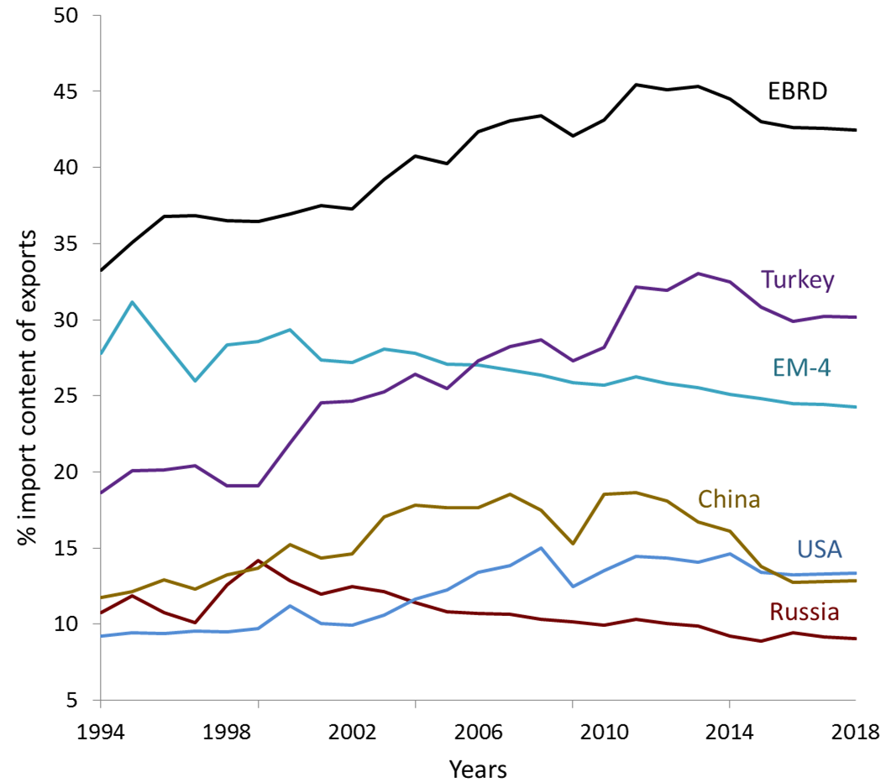
As intermediate goods cross borders, tariffs multiply inflating costs of final goods by much more than the tariff
Undoing global supply chains will be painful for businesses, costly for consumer -- but may be possible
Import content of exports averaged to 43 % in Central and SE Europe
Source: Eora Multi-Regional Input-Output data and author’s calculations. EM-4 comprises of Mexico, Malaysia, Brazil and India and EBRD comprises of countries in the EU customs union (Central Europe and Baltic States and Romania, Bulgaria, Cyprus and Greece).

Slide 16
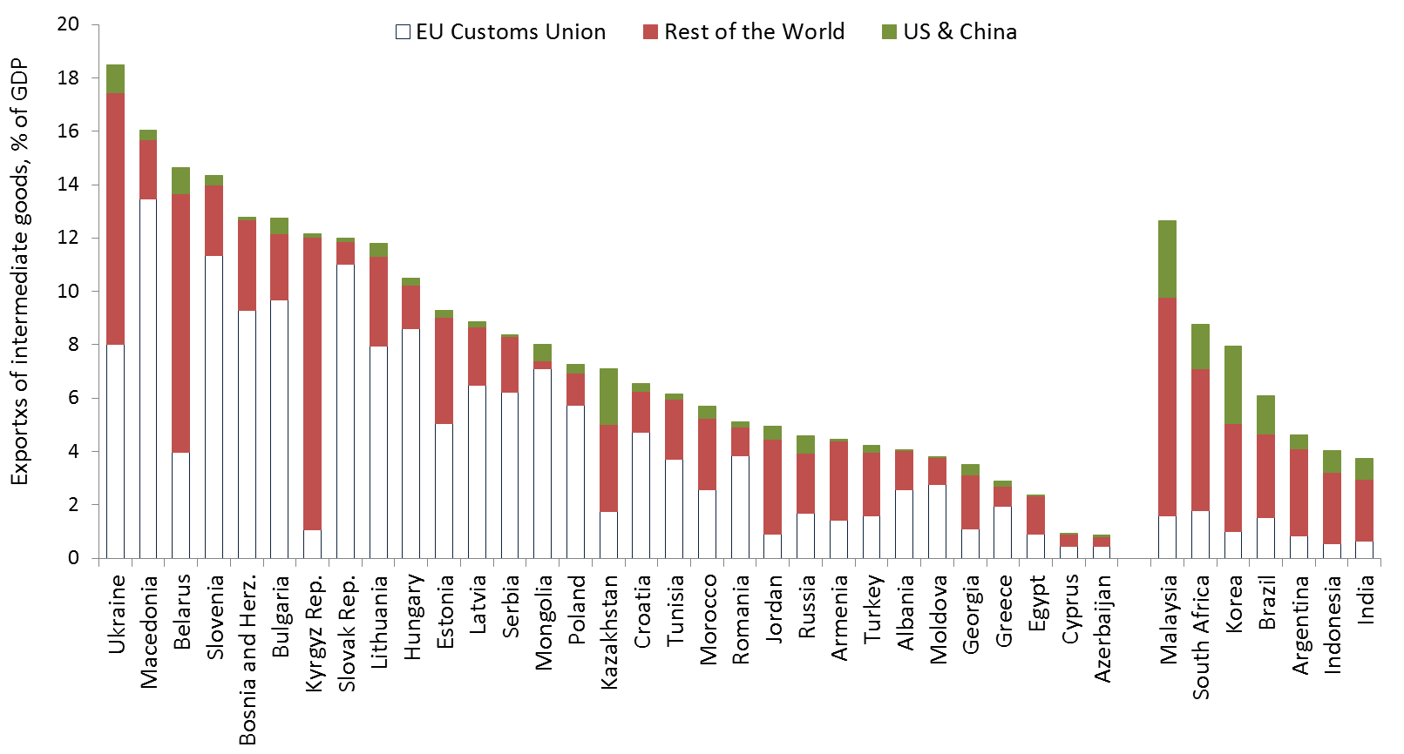
If trade wars escalate globally, risks are high for countries strongly integrated into global production chains
Emerging Europe has higher exports of intermediate goods (as % of GDP) than most other emerging markets – reflecting strong integration into “factory Europe”
Economies in Emerging Europe tend to be very strongly integrated into global value chains
Source: WITS, World Bank and author’s calculations.

Slide 17
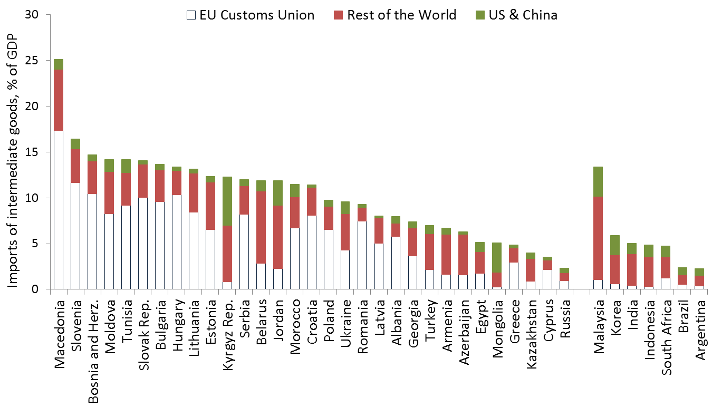
Mitigating factor: Many economies trade intermediate goods mostly within the EU customs union
Imports of intermediate goods in the EBRD regions come mostly from the EU customs union
Source: WITS, World Bank and author’s calculations.

Slide 18
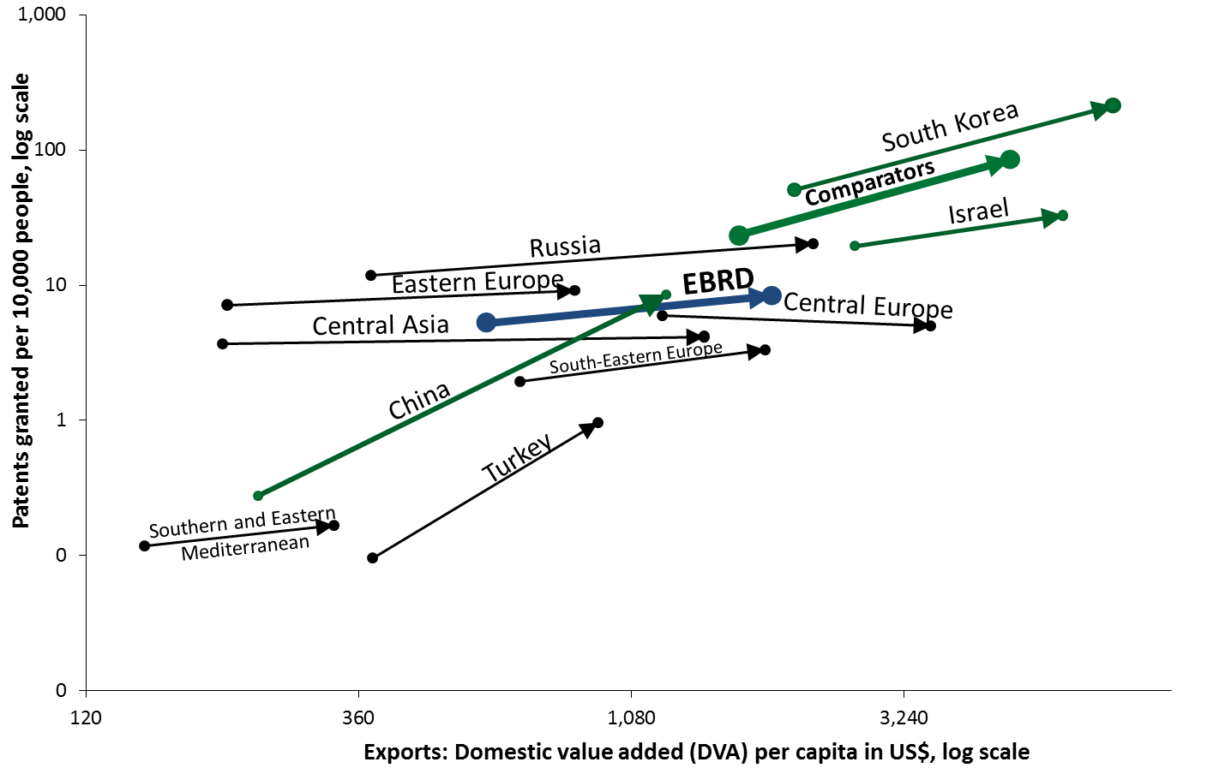
Long run: recreating supply chains domestically?
Innovation, management, size of markets
Easier to build a smartphone supply chain on the basis of a design facility than based on system cheap factories
Fast growth in domestic value added of exports in the EBRD regions
With few exceptions, not mirrored in growth in patenting and innovation – unlike in China, Korea or Israel
Innovation-light growth in the EBRD regions may be a challenge in this scenario
Source: WITS, World Bank and authors’ calculations.

Slide 19
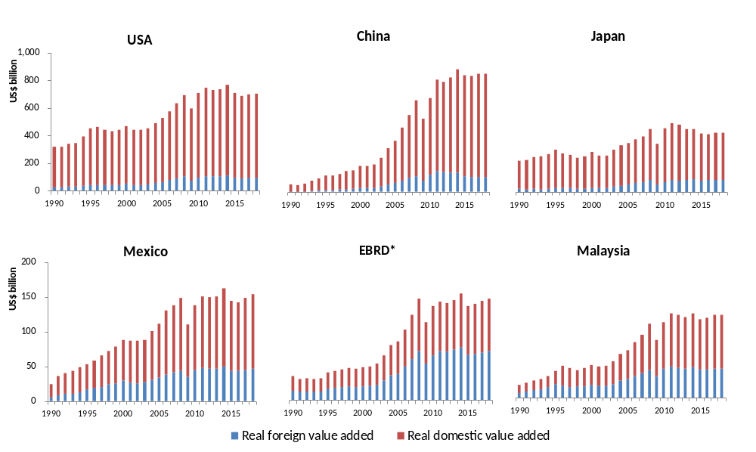
In China, most value added embedded in exports is domestic. Smartphones are exception, not the rule
Source: WITS, World Bank and authors’ calculations.
*EBRD stands for EU customs union members excluding Poland, Romania and Turkey.

Slide 20
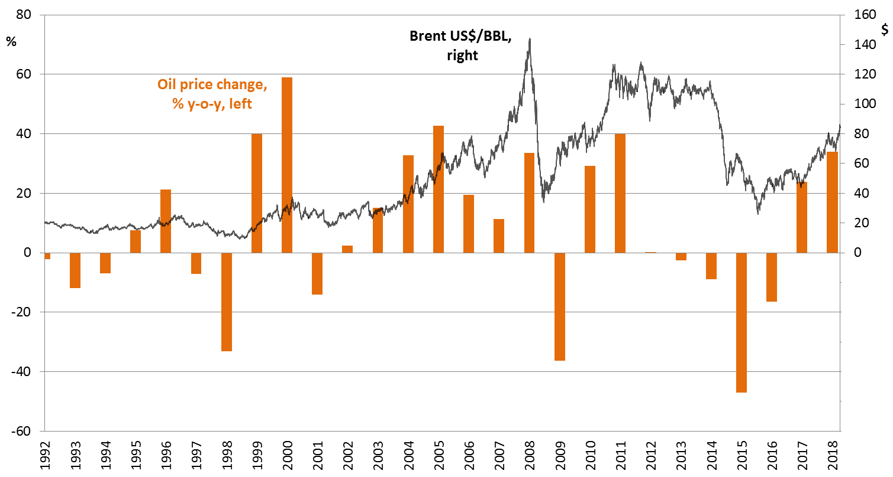
Brent has remained above US$ 70 / barrel since April 2018, on stronger demand, production caps
Brent surpassed US$ 80 per barrel in September– back to the levels of H2 2014
Lower supply from Venezuela, Iran, limitations of infrastructure in the US played a role
Change in annual average oil price (Brent), %
Source: Reuters and authors’ calculations.

Slide 21
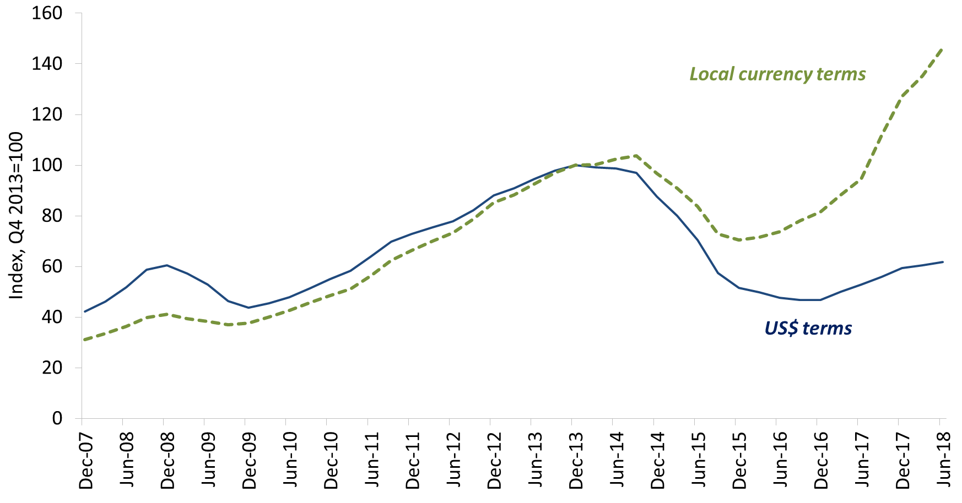
Remittances from Russia to Central Asia/MDA/Caucasus picked up by 19% in US$ terms in H1 2018
Yet on current trends, they are unlikely to surpass the 2013 peak
Remittances from Russia to Central Asia, Moldova and the Caucasus, index (Q4 2013 = 100),
4-quarter MA, inflation-adjusted
Source: Central Bank of Russia and authors’ calculations.

Slide 22
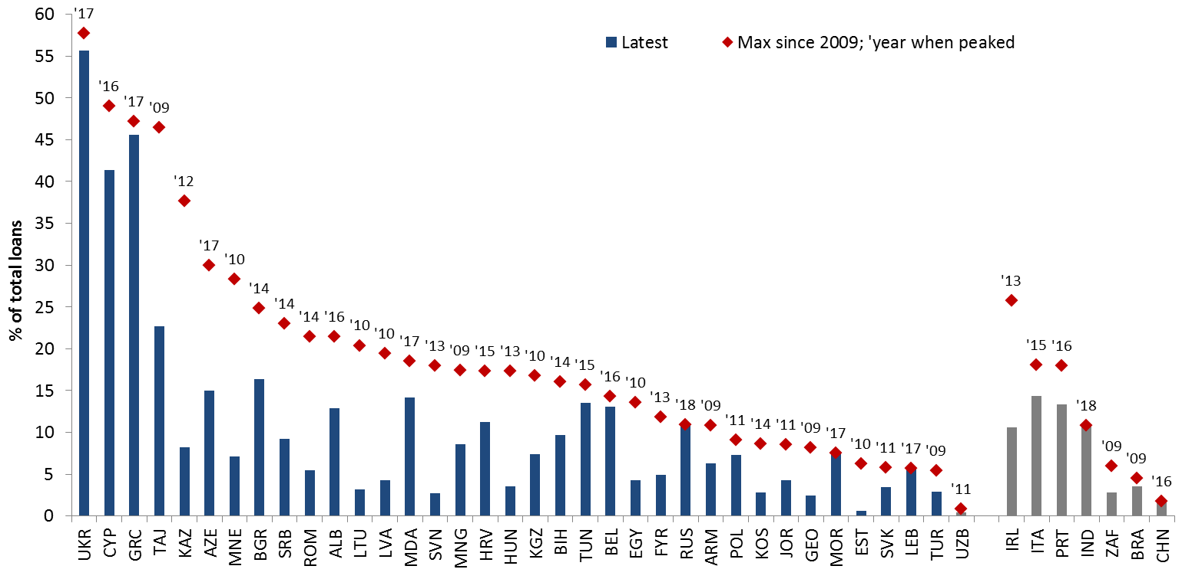
Reductions in NPLs on the back of policy actions, virtuous cycle of lower NPLs and economic upswing
Median NPL reduction of 10 percentage points since the peak – but high levels persist in several economies
Non-performing loans, % of total loans
Source: CEIC, national authorities and World Bank.

Slide 23
Concluding remarks: Stable growth amidst tightening financing conditions , escalating trade tensions
Growth in the EBRD regions has been stable at around 3.8% but increasingly driven by private consumption and to a lesser extent by investment or exports
Financing conditions for emerging markets have been tightening although they remain neutral in historical perspective
Tighter financing conditions may expose individual weaknesses – including those stemming from foreign currency / external borrowing in recent years
Turkey’s markets have come under pressure – on concerns about domestic policy, geopolitical risks and corporate indebtedness; spillovers from Turkey are expected to be limited
If trade wars escalate beyond US-China, they carry significant risks for the region as most economies are strongly integrated into global supply chains
Downward revision to growth (3.2% in 2018, 2.6% in 2019) mostly on account of Turkey; excluding Turkey growth has been revised up by 0.1 pp in 2018

Slide 24
Country developments

Slide 25
Away from Turkey growth remains solid, strengthening in SEMED and Eastern Europe and moderating elsewhere
GDP growth and population growth by sub-regions, %
Source: IMF, EBRD and authors’ calculations. Growth averages are population-weighted.

Slide 26
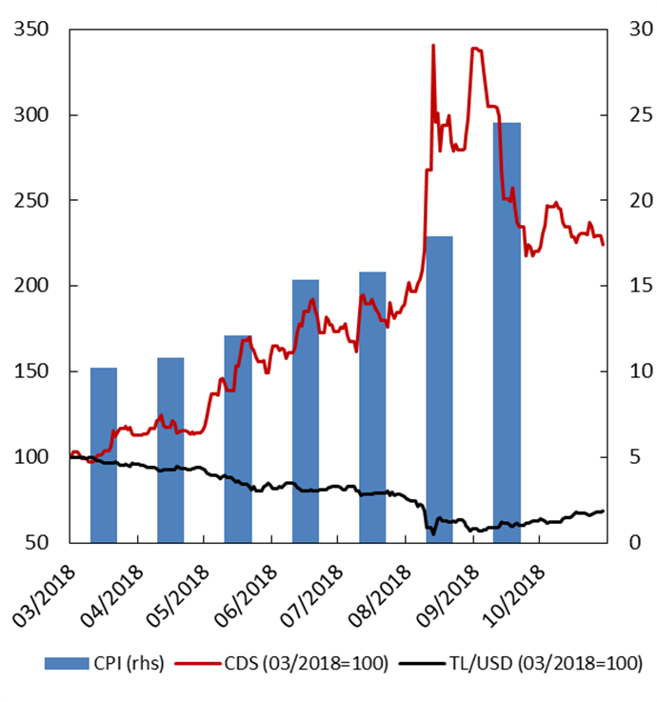
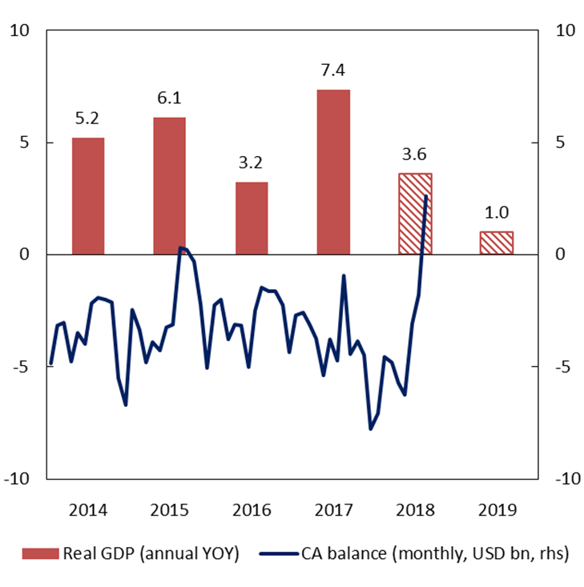
Turkey: a hard landing looks increasingly likely
Declining investor confidence drove depreciation and inflation
Signs of rebalancing emerging in the economy
Sources: Bloomberg, CBRT, TurkStat
Source: TurkStat

Slide 27
Ukraine: the outlook for recovery is bolstered by renewed cooperation with the IMF
Recovery has gained momentum
Real GDP growth, % change, year-on-year
Cooperation with the IMF remains vital
f/x public debt repayments, US$ billions
Source: State Statistics Service of Ukraine
Source: EBRD estimations based on NBU Inflation report, July 2018

Slide 28
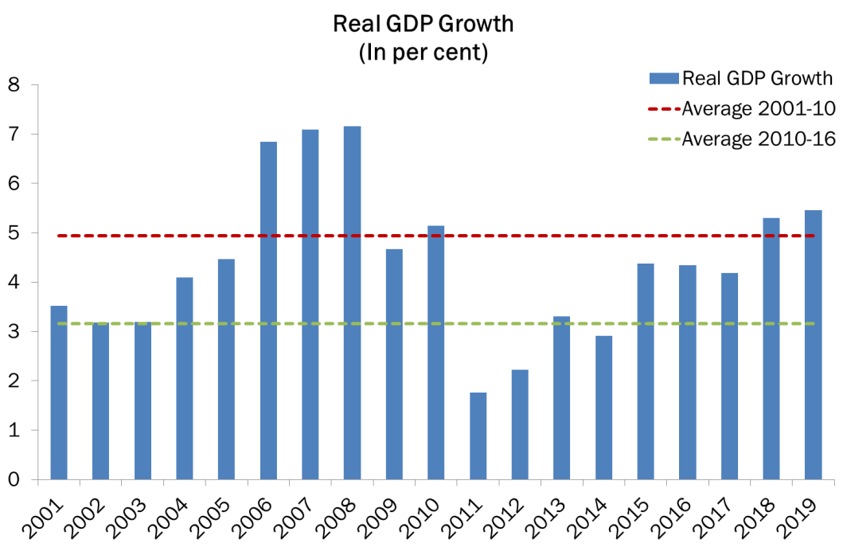
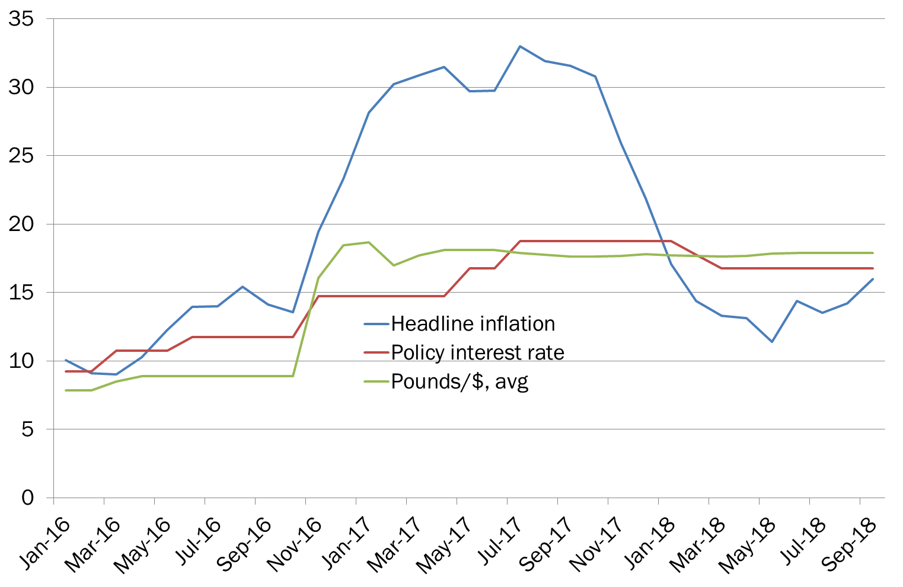
Egypt: the reform programme boosted exports but inflation persists
Real GDP Growth rebounded in FY2018
Inflation started to increase again
Source: National authorities.

